Slide 1
Pandas for IAC
September 28, 2022
Brie Pfisterer

Slide 2
What is Pandas?
Pandas is a popular open-source python library for data manipulation, analysis, and visualizations
Why use Pandas over other options?
Quick to learn
Works well with structured and tabular data
Can slice, dice, and manipulate data with ease
Great with time series or string manipulation

Slide 3
Common Uses for Pandas
Data Exploration
Preparation
Cleaning/Munging/Wrangling
Manipulation - ETL
Visualization

Slide 4
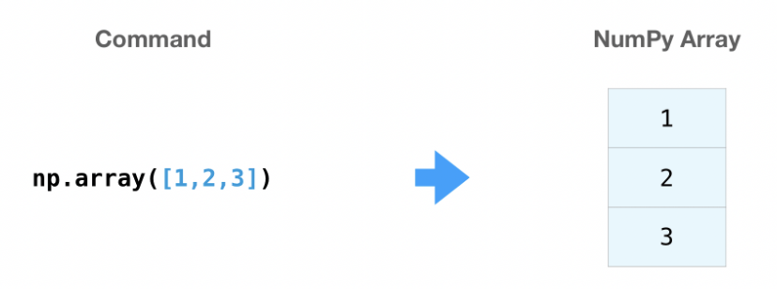
Before Pandas, there was NumPy
Built on python lists to make array objects (ndarray)
Processes 50X faster than standard lists for most operations
Memory efficient; better performance for small datasets
Image Source: https://numpy.org

Slide 5
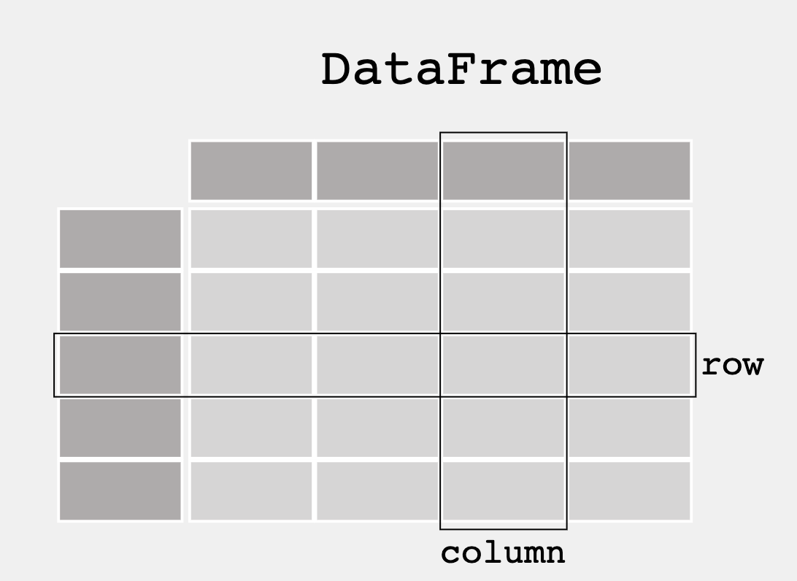
Pandas Basics
Data is represented as a Dataframe
2-dimensional data structure
Based on Numpy 2D Array
Better performance for larger data
500K or more rows
Image Source: https://pandas.pydata.org

